Slide 1
Introduction to Data Analysis

Slide 2
BASIC DATA ANALYSIS
Patrick Boily Data Action Lab | uOttawa | Idlewyld Analytics
pboily@uottawa.ca
[with files from Jen Schellinck | Sysabee]

Slide 3
DEPENDENT VS. INDEPENDENT VARIABLES
In an experimental setting:
control/extraneous variables: we do our best to keep these controlled and unchanging while other variables are changed
independent variables: we control their values as we suspect they influence the dependent variables
dependent variables: we do not control their values; they are generated in some way during the experiment, and presumably are dependent on everything
How do these translate over to other datasets?
Plant height
Sunlight hours

Slide 4
DATA TYPES
Numerical data: integers or continuous numbers
1, 7, 34.654, 0.000004
Text data: strings of text – may be restricted to a certain number of characters
“Welcome to the park”, “AAAAA”, “345”, “45.678”
Categorical data: a fixed number of values, may be numeric or represented by strings. There is no specific or inherent ordering
(‘red’,’blue’,’green’), (‘1’,’2’,’3’)
Ordinal data: categorical data with an inherent ordering. Unlike integer data, the spacing between values is not defined
(very cold, cold, tepid, warm, super hot)

Slide 5
DATA SUMMARIZING
Min: smallest value
Max: largest value
Median: “middle” value
Mode: most frequent value
Unique Values: list of unique values
etc.
Signal | Type
4.31 | Blue
5.34 | Orange
3.79 | Blue
5.19 | Blue
4.93 | Green
5.76 | Orange
3.25 | Orange
7.12 | Orange
2.85 | Blue

Slide 6
ROLLING-UP DATA
Signal | Type
4.31 | Blue
5.34 | Orange
3.79 | Blue
5.19 | Blue
4.93 | Green
5.76 | Orange
3.25 | Orange
7.12 | Orange
2.85 | Blue
We can perform operations over a set (or subset) of the data, typically over its columns.
Such an operation is akin to compressing or 'rolling-up' the many data values into a single representative value.
Examples: 'mean', 'sum’, 'count’, ‘variance’, etc.
We can apply the same roll-up function to many different columns, providing a mapping (list) of columns to values.
Count | Signal avg | Signal stdev | Type mode
9 | 4.73 | 1.33 | Blue/ Orange

Slide 7
CONTINGENCY/PIVOT TABLES
Contingency table: a table which examines the relationship between two categorical variables via their relative (cross-tabulation).
Pivot table: a table generated by applying operations (sum, count, mean, etc.) to variables, possibly based on another (categorical) variable. Contingency tables as special cases of pivot tables.
Type | Count | Signal avg | Signal stdev
Blue | 4 | 4.04 | 0.98
Green | 1 | 4.93 | N.A.
Orange | 4 | 5.37 | 1.60
 | Large | Medium | Small
Window | 1 | 32 | 31
Door | 14 | 11 | 0

Slide 8
ANALYSIS THROUGH VISUALIZATION
Analysis (broad definition):
identifying patterns or structure
adding meaning to these patterns or structure by interpreting them in the context of the system.
Option 1: use analytical methods to achieve this.
Option 2: visualize the data and use the brain’s analytic power (perceptual) to reach meaningful conclusions about these patterns.
We will discuss further.

Slide 9
DATA DESCRIPTIONS (REPRISE)
In a sense, the underlying reason for any analysis is to reach data understanding.
Studies and experiments give rise to units, which are typically described with variables (and measurements).
Variables are either qualitative (categorical) or quantitative (numerical):
categorical variables take values (levels) from a finite set of classes
numerical variables take values from a (potentially infinite) set of quantities

Slide 10
NUMERICAL SUMMARIES
In a first pass, a variable can be described along 2 dimensions: centrality & spread (skew and kurtosis are also used sometimes).
Centrality measures include:
median, mean, mode (less frequently)
Spread (or dispersion) measures include:
standard deviation (sd), variance, quartiles, inter-quartile range (IQR), range (less frequently).
The median, range and the quartiles are easily calculated from an ordered list of data.

Slide 11
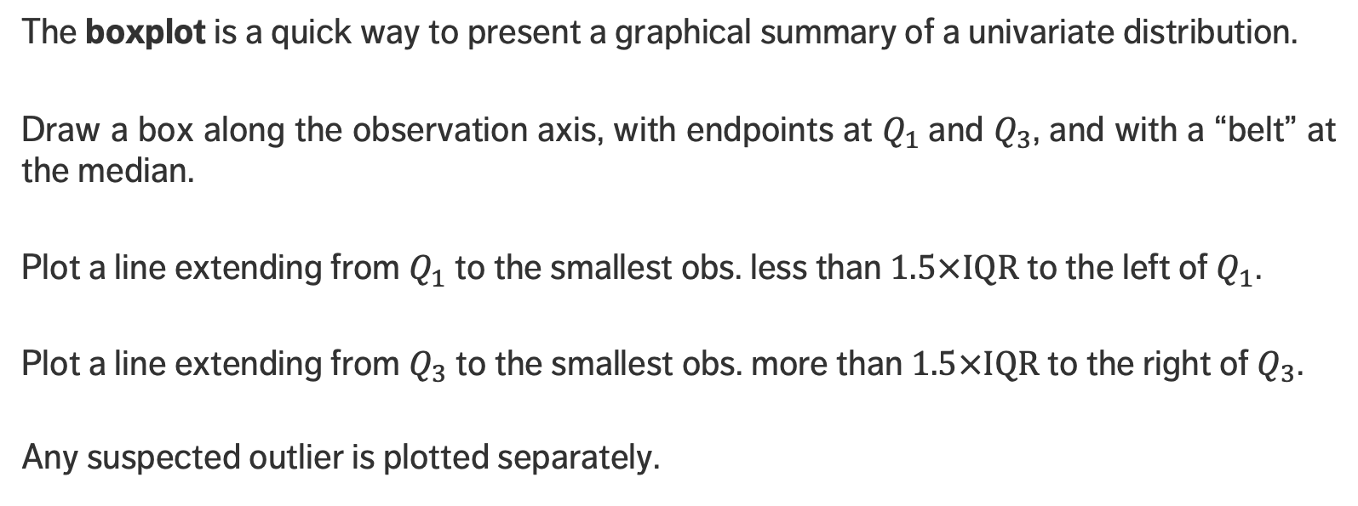
VISUAL SUMMARIES – BOXPLOT
The boxplot is a quick way to present a graphical summary of a univariate distribution.
Draw a box along the observation axis, with endpoints at $Q_{1}$and $Q_{3}$, and with a “belt” at the median.
Plot a line extending from $Q_{1}$ to the smallest obs. less than $1.5×IQR$ to the left of $Q_{1}$.
Plot a line extending from $Q_{3}$ to the smallest obs. more than $1.5×IQR$ to the right of $Q_{3}$.
Any suspected outlier is plotted separately.

Slide 12
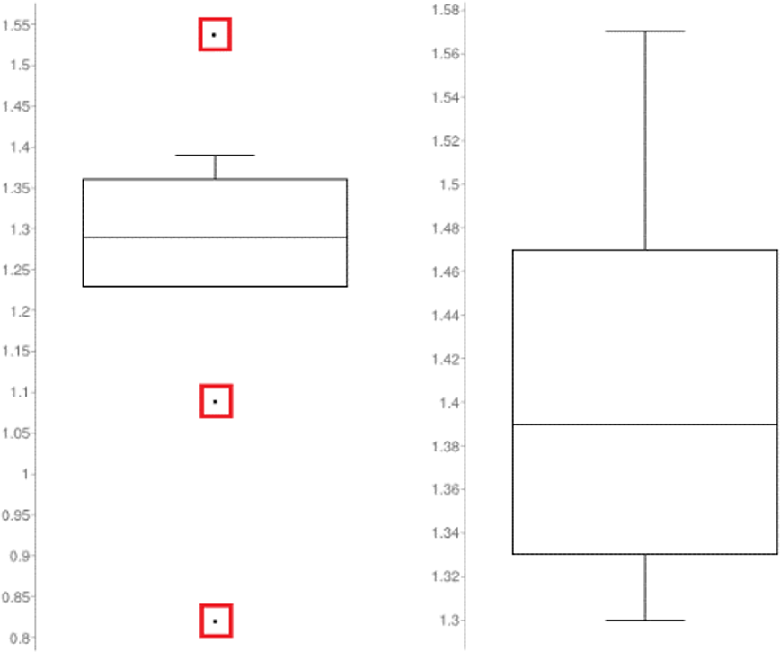
EXAMPLES
Queuing dataset: arrival rates (left), processing rates (right)

Slide 13
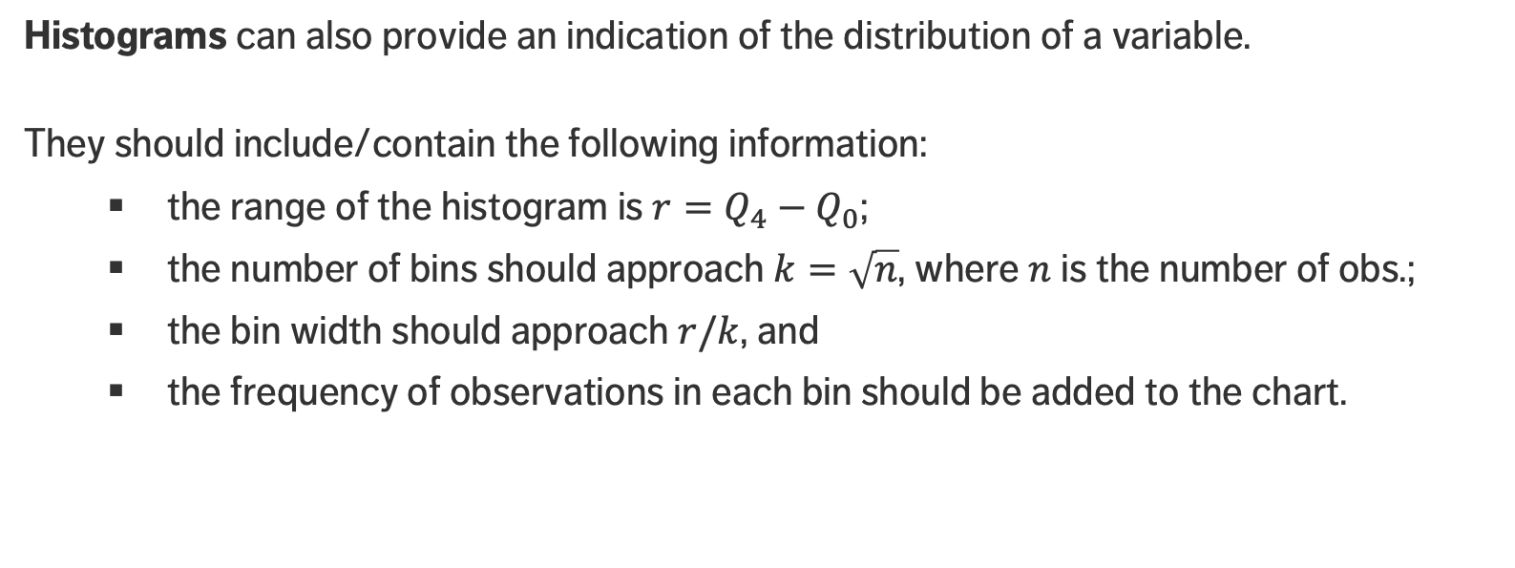
VISUAL SUMMARIES – HISTOGRAM
Histograms can also provide an indication of the distribution of a variable.
They should include/contain the following information:
the range of the histogram is $r=Q_{4}−Q_{0}$;
the number of bins should approach $k=\sqrt{n}$, where $n$ is the number of obs.;
the bin width should approach $r/k$, and
the frequency of observations in each bin should be added to the chart.

Slide 14
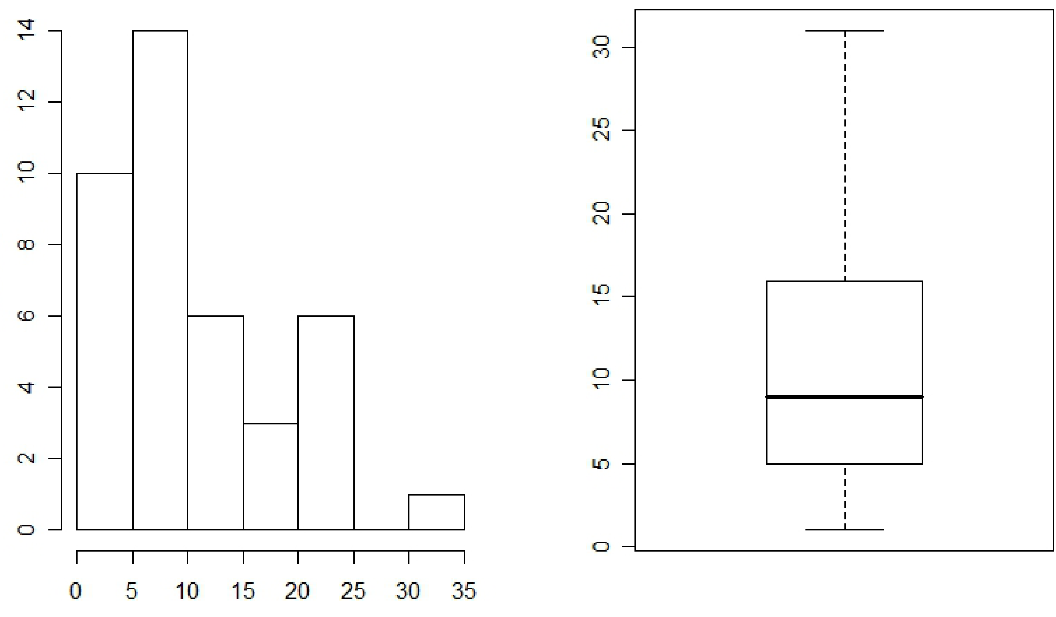

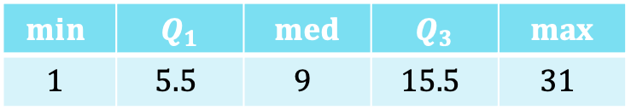
EXAMPLE
Is it more likely that one would see between 5-15 accidents on a given day, or between 25-35?
Consider the daily number of car accidents in Sydney over a 40-day period:
$$6, 3, 2, 24, 12, 3, 7, 14, 21, 9, 14, 22, 15,$$
$$2, 17, 10, 7, 7, 31, 7, 18, 6, 8, 2, 3, 2, 17,$$
$$7, 7, 21, 13, 23, 1, 11, 3, 9, 4, 9, 9, 25$$
The sorted values are:
$$1 2 2 2 2 3 3 3 3 4 6 6 7 7 7 7 7$$
$$7 8 9 9 9 9 10 11 12 13 14 14 15 17$$
$$17 18 21 21 22 23 24 25 31$$
$$min⁡$$ | $$Q_{1}$$ | $$med$$ | $$Q_{3}$$ | $$max$$
$$1$$ | $$5.5$$ | $$9$$ | $$15.5$$ | $$31$$

Slide 15
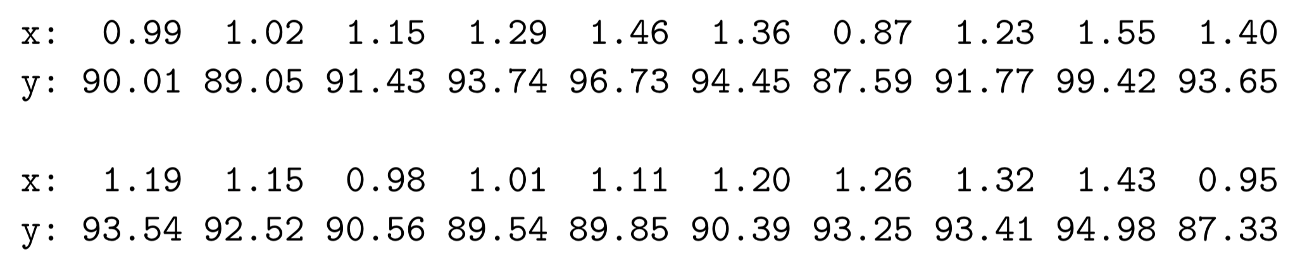
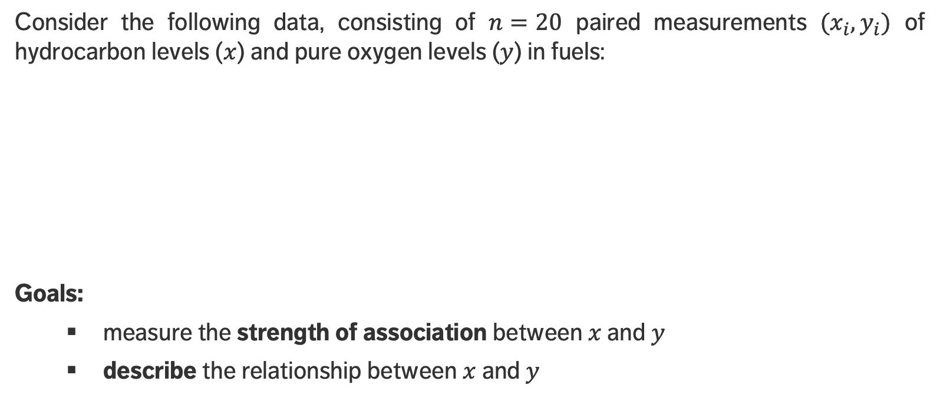
MOTIVATING EXAMPLE
Consider the following data, consisting of $n=20$ paired measurements $(x_{i},y_{i})$ of hydrocarbon levels ($x$) and pure oxygen levels ($y$) in fuels:
Goals:
measure the strength of association between $x$and $y$
describe the relationship between $x$and $y$

Slide 16

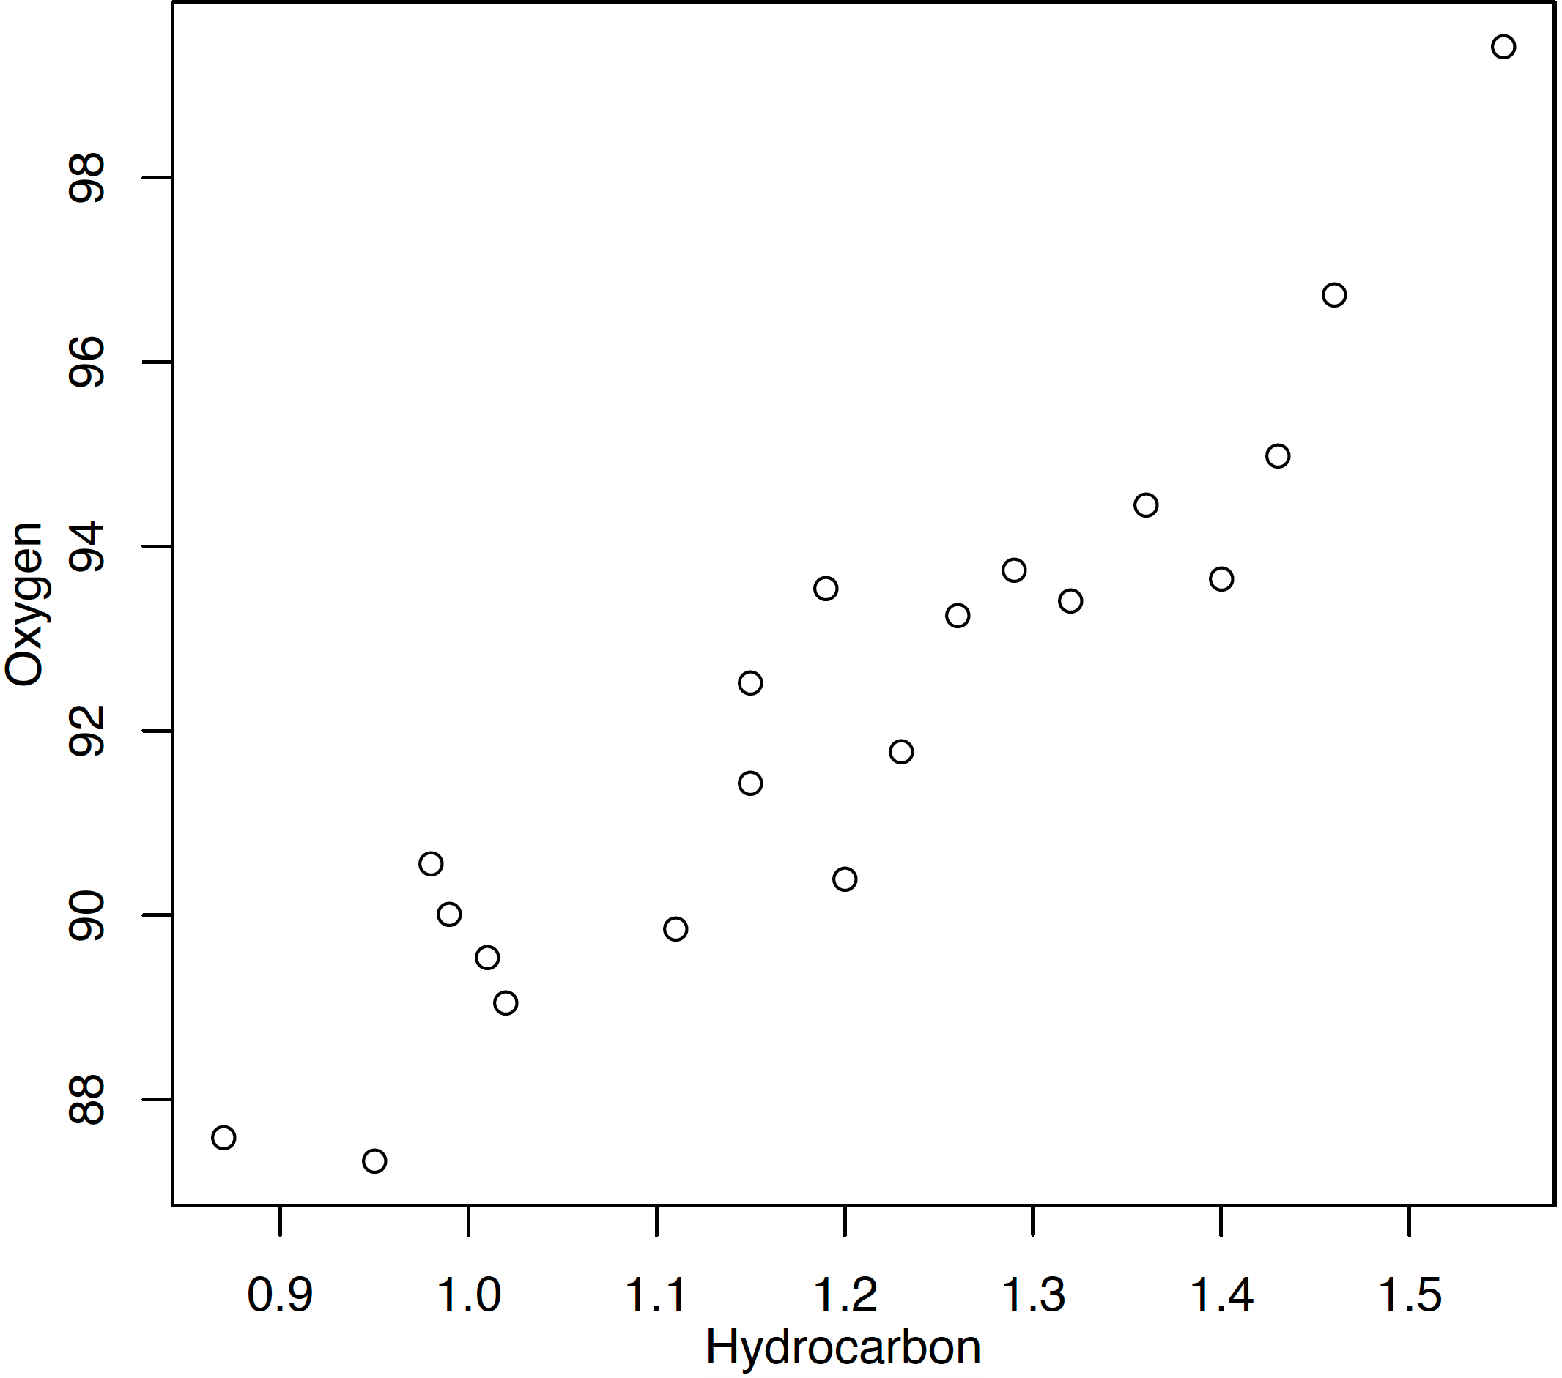
MOTIVATING EXAMPLE
A graphical display provides an initial description of the relationship.
It seems that points lie around a hidden line!
oxygen
hydrocarbon

Slide 17
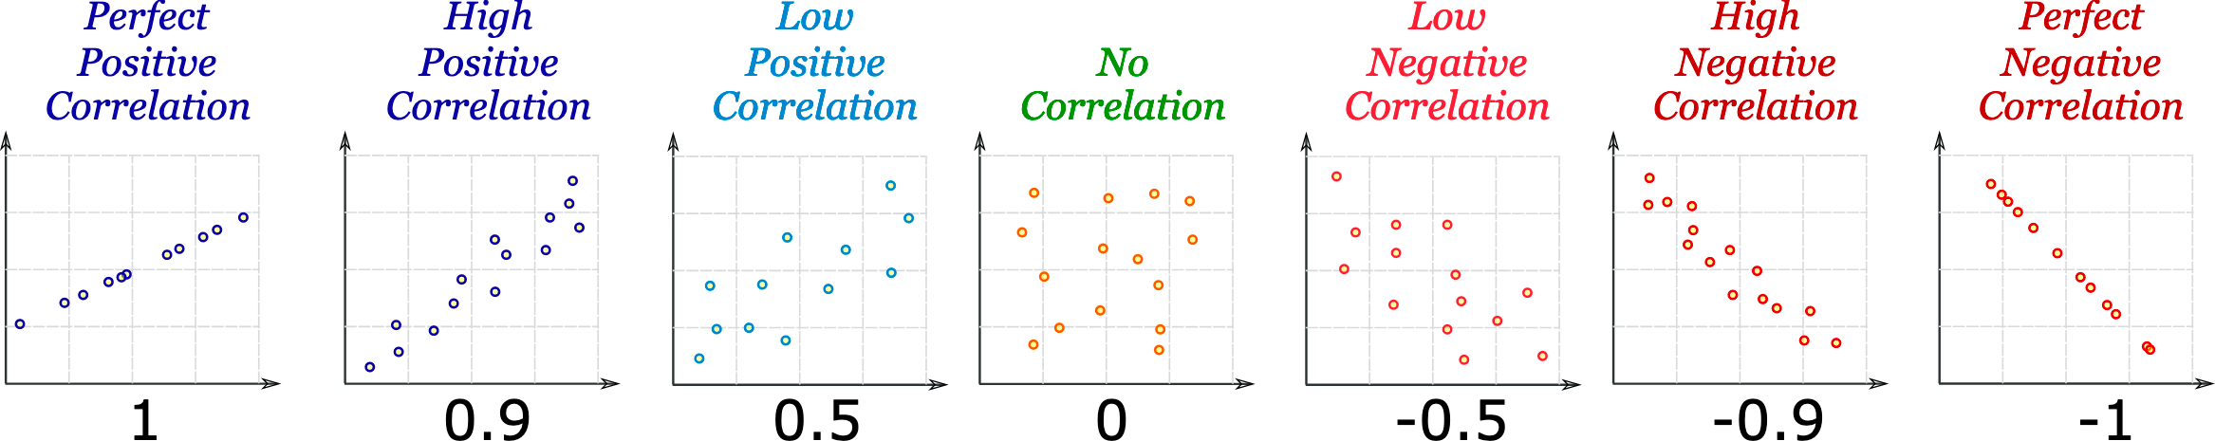
PROPERTIES AND INTERPRETATION
[Unknown author]
perfect positive correlation
high positive correlation
low
positive correlation
no correlation
low negative
correlation
high negative correlation
perfect
negative correlation

Slide 18
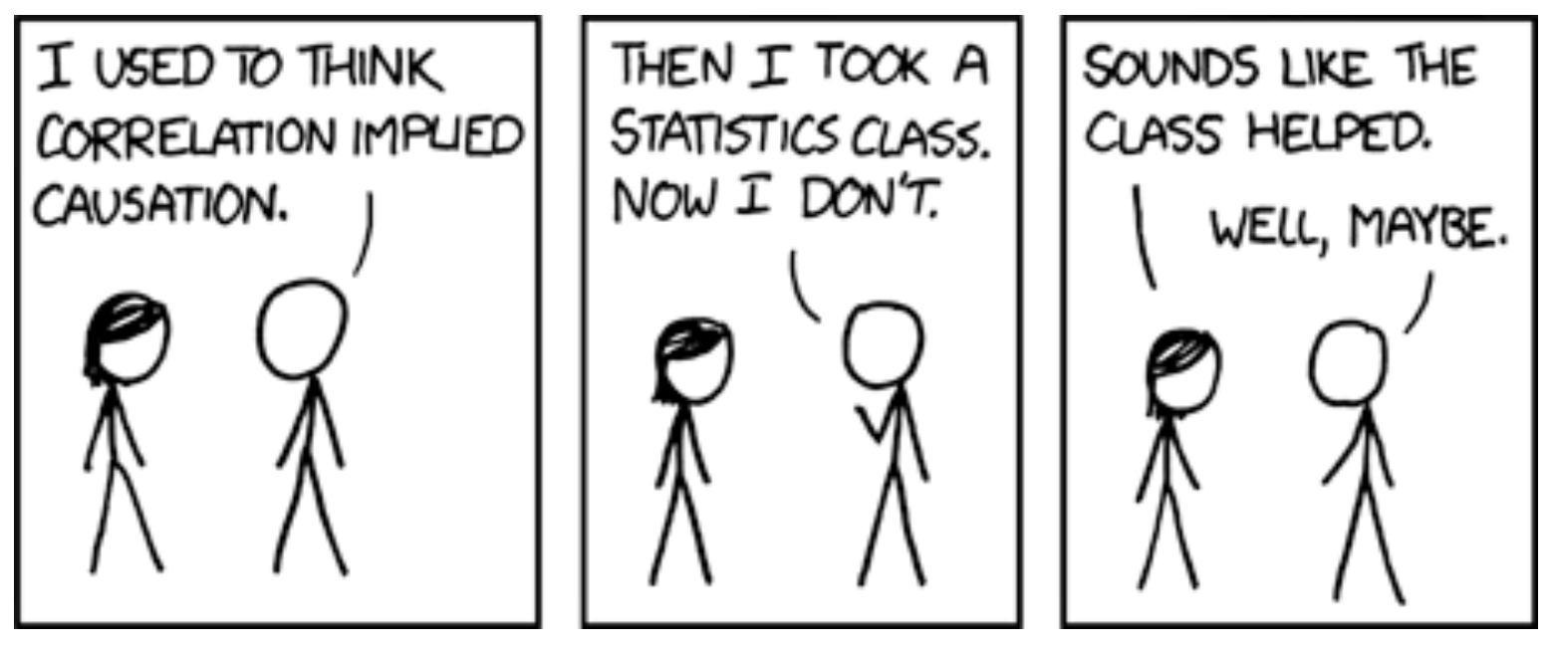
[https://xkcd.com/552/]
Correlation doesn't imply causation, but it does waggle its eyebrows suggestively and gesture furtively while mouthing 'look over there'.

Slide 19
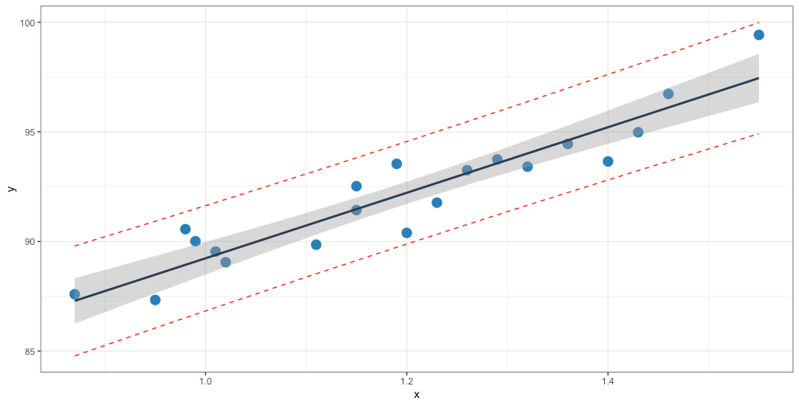

LINEAR REGRESSION
If ${\hat{β}}_{i}$ is the estimate of the true coefficient $β_{i}$, the linear regression model associated with the data is
$$\hat{Y}\left(x\right)= {\hat{β}}_{0}+{\hat{β}}_{1}x_{1}+⋯+{\hat{β}}_{p}x_{p}=βx$$
oxygen
$$\text{oxygen}=14.95 × \text{hydrocarbon}+74.28$$
confidence interval for mean response
prediction interval for new responses
hydrocarbon

